Slide 1
Traffic Incident Forecast
Ryan & Anudeep

Slide 2
Approach
Research instead of ‘Hackathon’
Comparative study between CPU solution & NVIDIA SPARK GPU solution
  Design a STRONG base solution architecture first
    Medallion architecture for data pipeline
      API -> Bronze (raw)
      Bronze -> Silver (structured)
      Silver -> Gold (H3, hour incident aggregates)
      Rich Gold (hourly lags, rolling statistics: min max mean std)
    Model competition pipeline for training
      Linear, Poisson, RF, XGBoost regressors
      3-fold CV and hold out performance stats (RMSE, R^2, latency)
      Select champion model
    Serving layer
      Data pipeline -> champion model serve -> front end
  Build solution architecture on CPU and Spark, then compare
    CPU stack: numpy, pandas, sklearn, CPU processing
    GPU stack: cuPy, cuDF, cuML, DGX Spark GPU processing

Slide 3
Core Philosophy
Data Product first
  Medallion architecture with clear data contracts: Bronze → Silver → Gold → Rich Gold enables plug-and-play data products
  Data product-first design: conform to structure once, flow through pipeline automatically
  Fuzzy merging by location & time with neighbor fallback ensures complete coverage without data loss
Build a STRONG architecture second
  Diligence and strategy for a CPU build to discover
    Feasibility and performance
    Early pain-point discovery
      Data leakage, unfair-advantage aggregations (look forward time indexing)
    Pipeline optimization and smoothing
Build on the NVIDIA DGX Spark using NVIDIA Stack
  Methodology preservation: identical pipeline, same CV, feature parity
  Library replacement: (pd, np, sklearn) -> (cuDF, cuPy, cuML)
  Performance optimizations: RMM memory pool (RAPIDS), GPU-native batch processing, zero-copy operations
  100% GPU-first architecture with strategic CPU fallbacks and an “apples-to-apples” comparison setup

Slide 4
Training Results
Metric | CPU Champion | GPU Champion | Difference
Model | XGBoost | XGBoost_GPU | Same algorithm, different hardware
Platform | CPU (standard) | NVIDIA GB10 (Blackwell) | GPU-accelerated
R^2 | 0.9910 | 0.9288 | CPU: +6.7% better
RMSE | 0.0144 | 0.0407 | CPU: 64.6% lower (better)
Training Time | 5.26s | 42.98s | CPU: 8.2x faster
Inference Latency (p50) | 11.74ms | 5.37ms | GPU: Very fast inference
Training Data - Rows: 3,909 records, Features: 105 numeric features

Slide 5
Conclusion
CPU solution would be best for this project
  Superior regression metrics and lower prediction error
  But what if more data?
    We would see GPU handling much richer data and scaling better
      At n = 4000 rows, GPU inference ~ 2X faster
      At O(n) complexity
        CPU sequential pointing, cache vs GPU SMID, global memory
        At n = 10,000 rows the GPU would be 10-20X faster
    But why would we do more data when CPU XGBoost is already R^2 0.991 (no leakage confirmed)?
      Do we need more training data for a better “next hour” predictor? - (0.01 RMSE) No
      Is 2X time saving huge at our current inference OoM? (6.5 ms) No
      CPU solution would be cheaper to host and scale horizontally as part of a K8s cluster with CPU based pods in container runtime
Careful solutioning can save money
  By focusing on the data product and a strong logical architecture
  And patiently creating a strong CPU baseline first
  We show this is a better approach to real-world solution over “throwing the kitchen sink” at a GPU

Slide 6
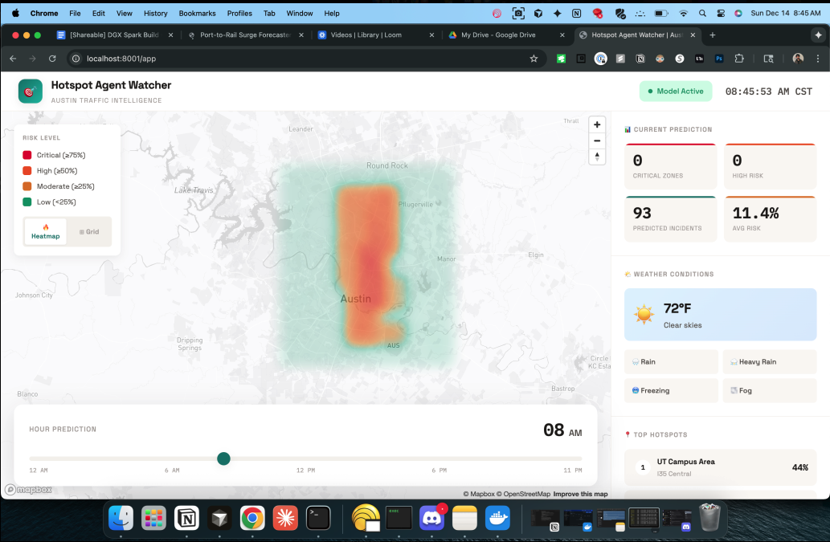
DEMO

